Slide 1
Welcome!
The workshop will include interactive segments. In order to participate*, make sure you do the following before we begin:
Complete the installations that were sent to you yesterday.
git clone https://github.com/ofek-bs/cs_hackathon_flutter.git
Open the cloned folder in your IDE, make sure that you’re working on the master branch, run your emulator and run the given code as you’ve learned.
* The interactive parts can be done in groups ☺

Slide 2


Android Workshop
CS Hackathon 2023 | Ofek Bengal Shmueli

Slide 3
Plans For Today
Understand what Flutter’s all about and why is it recommended to use.
Learn the basic UI concepts in depth.
See some actual code and play with it.
Overview interesting features and packages that might be useful for your projects.
Get to know great self-learning sources, mainly for documentation, packages, etc.
Questions?

Slide 4
Plans For Today
Understand what Flutter’s all about and why is it recommended to use.
Learn the basic UI concepts in depth.
See some actual code and play with it.
Overview interesting features and packages that might be useful for your projects.
Get to know great self-learning sources, mainly for documentation, packages, etc.
Questions?

Slide 5



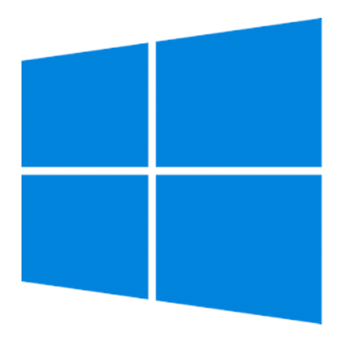
Motivation
Java, Kotlin, XML
(Android Native)
Swift, Obj-C
JS, HTML, CSS
C#
We need to specialize in different languages for different devices.
What about other smart devices / platforms?
Logic and UI are often separated and hard to maintain.

Slide 6
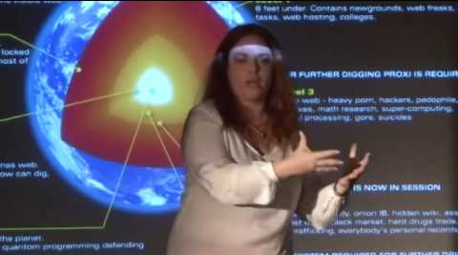


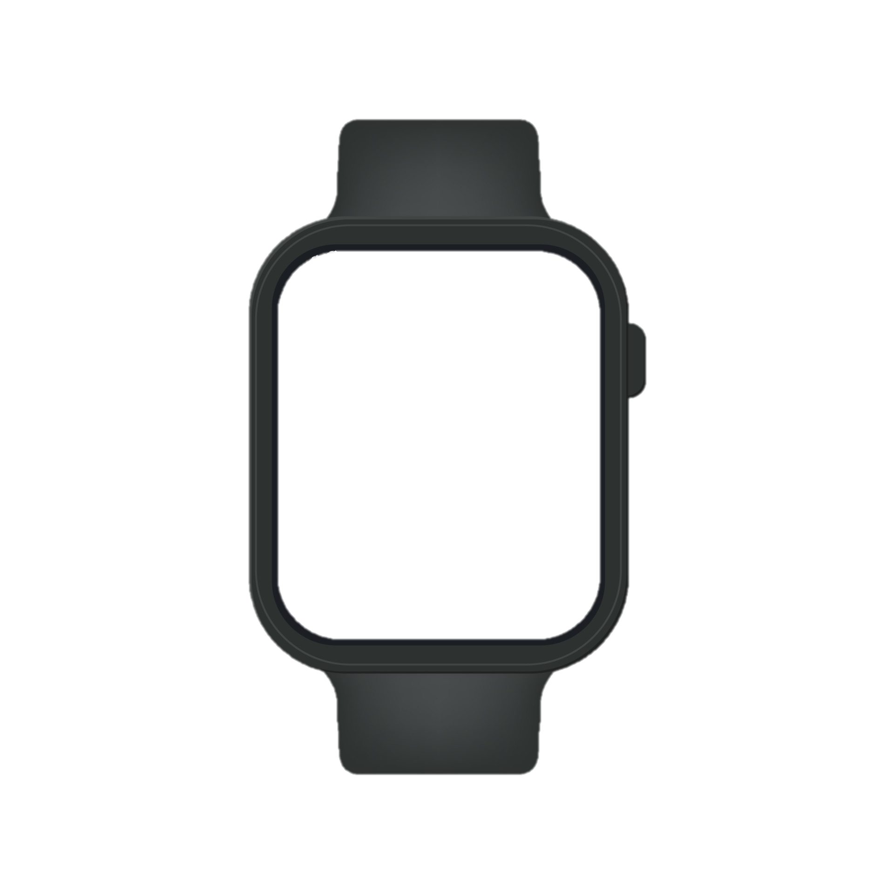

Motivation

Slide 7


Context
Flutter is Google’s toolkit for building cross-platform apps, using a single programming language.
Tools for compiling, debugging, testing
Foundation library (primitives, utility classes and functions)
UI library (widgets)
That programming language is called Dart.

Slide 8
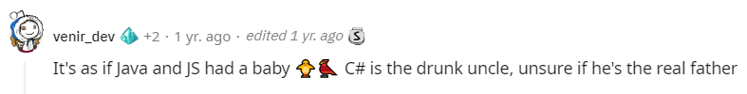
Dart in a nutshell
Mainly used for UI & consumer applications.
Similar to other languages you (possibly) know and (certainly) love.
Interesting features:
OOP!
Support for asynchronous development (future, async, await)
Notes:
כמה פרטים זריזים עליה כדי שתקבלו תחושה:
שפת Object oriented, משתמשים בה בעיקר כדי לעצב UI לאפליקציות לטלפון, לווב וכו'. פותחה ע"י גוגל אבל open source.
יש שתי דרכים לקמפל אותה ואנחנו נפגוש את שתיהן בעבודה, כבר בתרגיל בית 1:
AOT (כמו בג'אווה). מקמפלים את כל הקוד מראש, לקוד מכונה שמוכוון למכונה ספציפית. יתרון: זה קורה מראש לכן בזמן ריצה אין פגיעה בביצועים, הכל זז חלק. חסרון: תוך כדי עבודה אם שינינו משהו קטנטן, כמו צבע רקע או אחד הכיתובים (שזה מאוד נפוץ בהקשר של UI) צריך לקמפל הכל מההתחלה וזה לא אידיאלי.
בשביל זה יש JIT, שמאפשר פיתוח יותר מהיר – עושים שינוי קטנטן, מקמפלים דרך JIT ורק החלק הרלוונטי שהשתנה עובר קמפול מחדש. רואים מיד את התוצאה – בשקופית הבאה דוגמה.

Slide 9
Plans For Today
Understand what Flutter’s all about and why is it recommended to use.
Learn the basic UI concepts in depth.
See some actual code and play with it.
Overview interesting features and packages that might be useful for your projects.
Get to know great self-learning sources, mainly for documentation, packages, etc.
Questions?

Slide 10
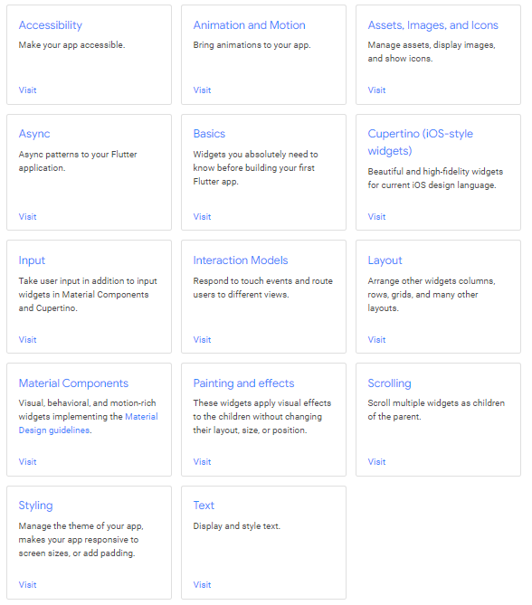
Widgets
(Almost) everything is a widget.
Lists, buttons, images, text fields…
Flutter UI is built by composing widgets.
Flutter code defines a giant hierarchy of widgets
Also known as The Widget Tree.
Follows Material Design.

Slide 11
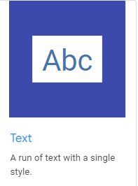
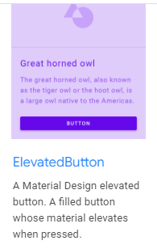
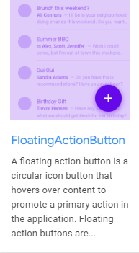
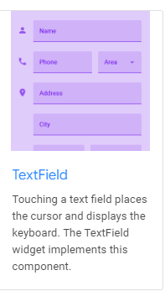
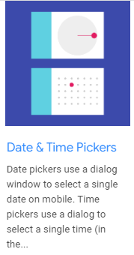
Basic Widgets - Examples

Slide 12
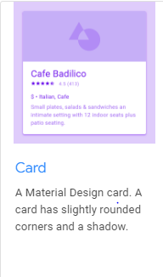
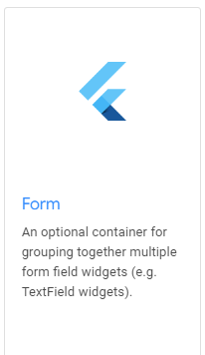
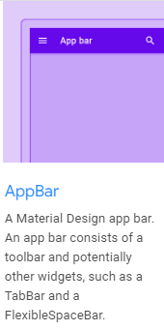
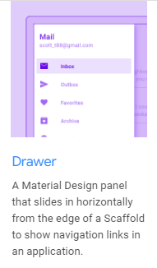
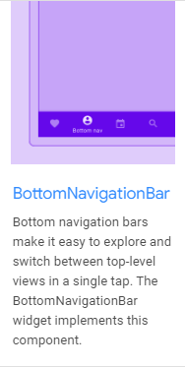
Basic Widgets - Examples

Slide 13
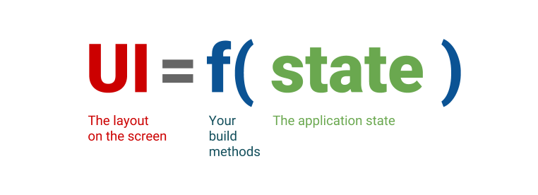
Reactive Programming
State = all the information that is part of the widget / app.
Variables (their values)
User input
Cache, Etc.
Declarative UI = User interface is defined declaratively, as the result of a constant function (build) given the current state.

Slide 14
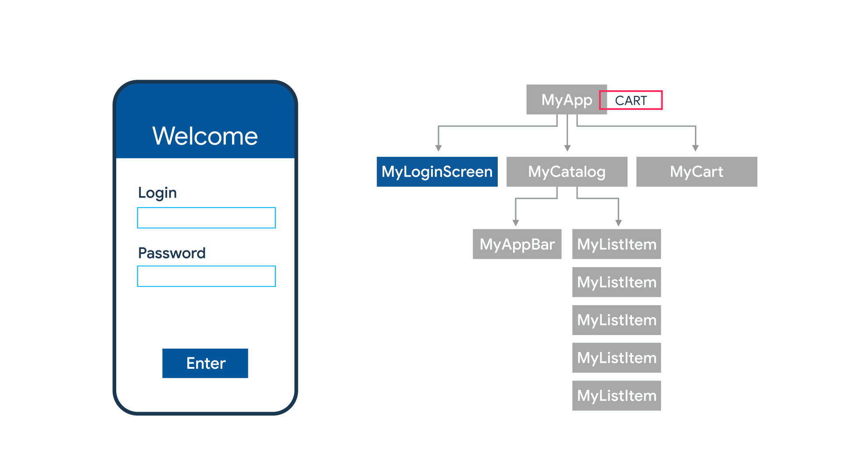
Reactive Programming (cont.)
Flutter is a declarative and reactive framework:
The developer declares how the program should behave (By managing the state and hierarchy of the UI), and the framework handles (most of) everything else.
The program changes its state and UI by reacting to changes in data.

Slide 15
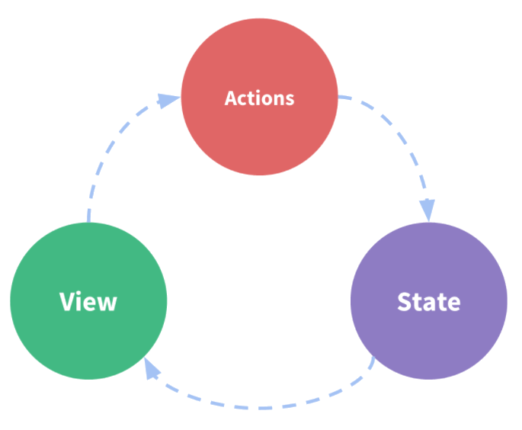
Reactive Programming (cont.)
In Reactive programming, we can divide any application into 3 parts:
The state – source of truth that drives the app.
The view – a declarative mapping of the state.
The actions – the possible ways the state could change in reaction to user inputs from the view.

Slide 16
Stateless Widgets
Stateless Widgets are the simplest form of widgets, and don’t maintain a state.
In other words, UI = f(initial configuration), and therefore UI is immutable.
Their build method is called less often. Therefore, they offer better performance.
Studio cheat: stless + Enter = StatelessWidget.

Slide 17
DEMO

Slide 18
Layout Widgets
In other platforms, arrangements of UI components is done with XML, CSS…
Here, the arrangement is also done with widgets.
Examples:
Arrange widgets horizontally / vertically by wrapping them with Row / Column.
Center a widget by wrapping it with a Center widget.
Add padding, background color and much more with Container.

Slide 19
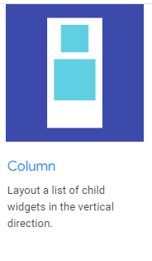
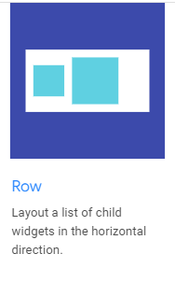
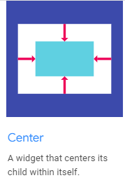
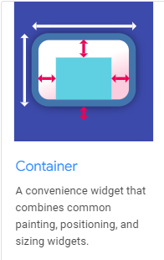
Layout Widgets - Examples

Slide 20
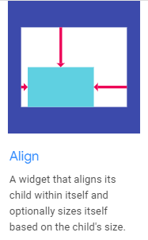
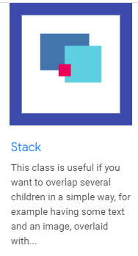
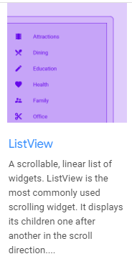
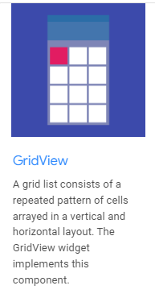
Layout Widgets - Examples

Slide 21
Exercise 1
In the cloned git repo, switch to the 1_stateless branch.
In main_screen.dart, add the necessary code such that:
A rectangle button is added below the text.
The button should contain the text “My Button”.
Both the text and button are centered (middle of the screen).
It is recommended to use online sources!

Slide 22
Stateful Widgets
Stateful Widgets hold a state.
In other words, UI = f(current state), and therefore UI is mutable.
To update the state of the widget, wrap mutable changes with a call to setState().
Such a call marks the wrapping widget as “dirty”, thus causing a rebuild for the widget (and the subtree below) = calling build = redrawing related UI according to the updated state.
Composed of a state class (where all the logic is added) and a regular widget class.
Studio cheat: stful + Enter = StatefulWidget + State class.

Slide 23
DEMO

Slide 24
Exercise 2
In the cloned git repo, switch to the 2_stateful branch.
In egg_screen.dart, add the necessary code such that:
The app reacts to the change in state (_count’s value): The text that reads the current count value should change when the egg is tapped; the egg should break after a few taps.
Increase the font size for the “_ clicks” label.
Make the “_ clicks” label bold.
It is recommended to use online sources!

Slide 25
Plans For Today
Understand what Flutter’s all about and why is it recommended to use.
Learn the basic UI concepts in depth.
See some actual code and play with it.
Overview interesting features and packages that might be useful for your projects.
Get to know great self-learning sources, mainly for documentation, packages, etc.
Questions?

Slide 26
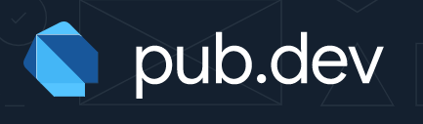
Flutter Packages
Flutter support using shared packages, contributed by other developers, to allow quickly building an app without having to develop everything from scratch.
There are packages for almost everything!
Packages are added are updated on a daily basis.
You can create packages too ☺
You can find them in pub.dev.

Slide 27
Camera Interaction
Sometimes we need access to the user’s camera, to take pictures or capture video.
For example: Uploading an avatar picture.
We can use the camera package.
This package provides us with 2 main interfaces:
CameraPreview widget, for getting a feed from the camera.
CameraController for controlling the camera
Taking pictures
Switching camera
Recording video, etc.

Slide 28
Camera Interaction – Example (1/2)
class _MyHomePageState extends State<MyHomePage> { late CameraController cameraController;
bool cameraReady = false; @override void initState() {
super.initState();
startCamera(); }
void startCamera() async {
List<CameraDescription> cameras = await availableCameras();
cameraController = CameraController(cameras[0], ResolutionPreset.high);
await cameraController.initialize();
setState(() { cameraReady = true; });
}
@override void dispose() {
super.dispose();
cameraController.dispose(); } }

Slide 29
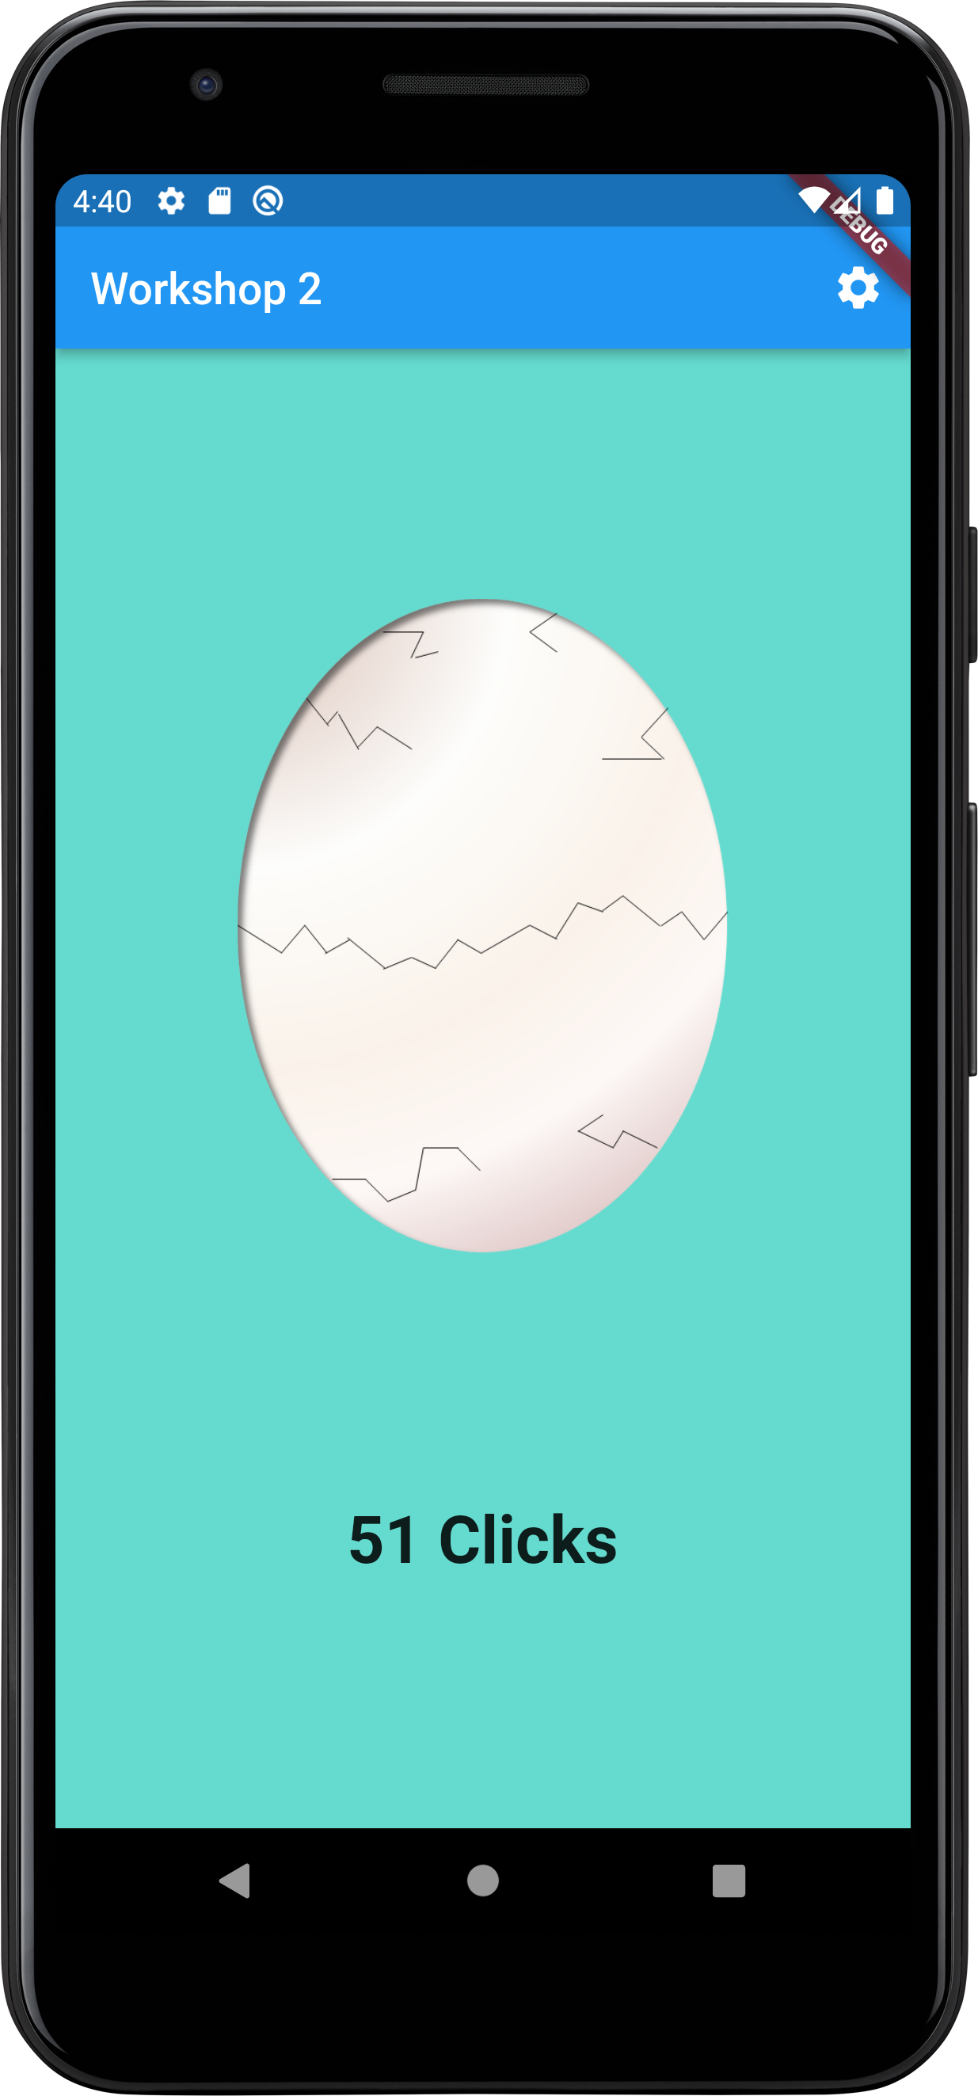
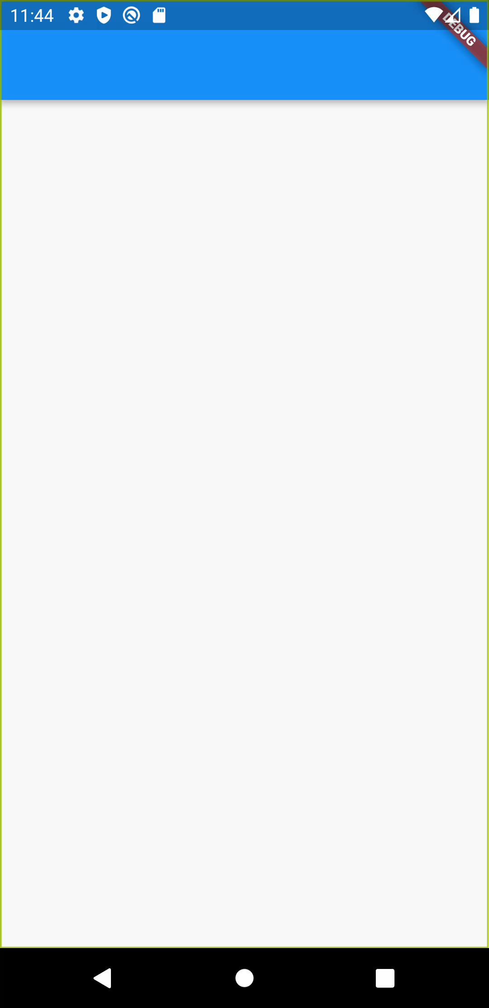
Camera Interaction – Example (2/2)
class _MyHomePageState extends State<MyHomePage> { @override Widget build(BuildContext context) {
return Scaffold(
appBar: AppBar(),
body: cameraReady ? CameraPreview(cameraController) : Container();
); } }
After initializing the controller, we can use it for many camera features, such as taking pictures, changing zoom level, etc.
cameraController.takePicture(path);

Slide 30
Location awareness
Sometimes we want our application to be location-aware.
For example: Navigation apps.
We can use the location package.
Allows us to get live location of our device and be notified whenever it changes.
We access the package’s functions via an instance:
var location = Location();
Notes:
.

Slide 31
Location awareness (cont.)
In order to access the device’s location, we need to:
Make sure that the device’s location service is enabled.
Make sure that the app’s location permission is granted.
var serviceEnabled = await location.serviceEnabled();
if (!serviceEnabled) {
serviceEnabled = await location.requestService();
if (!serviceEnabled) {
return;
}
}
var permissionGranted = await location.hasPermission();
if (permissionGranted == PermissionStatus.denied) {
permissionGranted = await location.requestPermission();
if (permissionGranted != PermissionStatus.granted) {
return;
}
}
setState(() { _locationAvailable = true; });
Notes:
.

Slide 32
Location awareness (cont.)
Now, we can access our device’s latest known location with:
Or request location updates in a Stream:
We can also change the update interval and accuracy:
var _locationData = await location.getLocation();
location.onLocationChanged.listen((newLoc) {
print(newLoc);
});
location.changeSettings(
accuracy: LocationAccuracy.powerSave,
interval: 10000, // Every 10 seconds
);
Notes:
.

Slide 33
Location awareness – Maps
Sometimes we want to display location-based information for our users on a map.
We have 2 recommended APIs for that: Google Maps and Leaflet
Cons | Pros | Package | API
Not very customizable Limited quota | Supported by Google Easier to setup | google_maps_flutter | Google Maps
Relatively new No official Google support | Highly customizable Free for life | flutter_map | Leaflet
Notes:
.

Slide 34
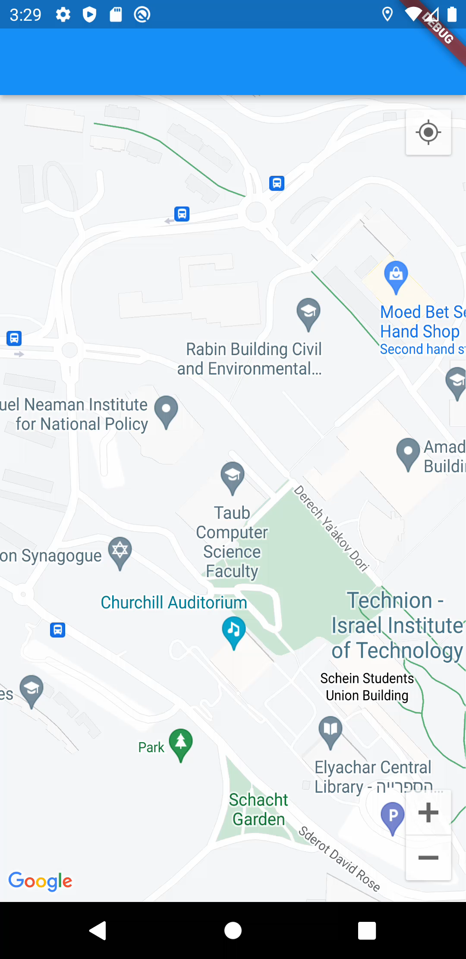
Location awareness – Google Maps
We set some fixed initial position for our map:
In our build function, we use a GoogleMap widget:
We can use different MapTypes, such as hybrid and satellite.
late GoogleMapController mapController;
Final _initialPos = const LatLng(32.7777353, 35.0216254);
GoogleMap(
onMapCreated: (controller) {
mapController = controller;
},
initialCameraPosition:
CameraPosition(target: _initialPos, zoom: 18),
mapType: MapType.normal,
myLocationEnabled: true,
myLocationButtonEnabled: true,
zoomControlsEnabled: true,
)
Notes:
.

Slide 35
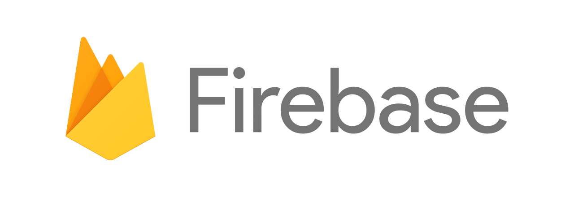
Firebase Services
A Google platform which provides a variety of cloud services, along with an intuitive SDK. Suitable for small to medium-scale projects.
In Flutter, we use those services via the official packages:
firebase_auth allows users to sign up and log into the app, with a classic email/password credentials or with Facebook/Google/Phone…
cloud_firestore allows users to maintain an easy-to-use NoSQL database, listen to changes and respond to them, queries…
firebase_storage allows users to save files in the cloud: images, profile pictures, PDFs, chat logs…
firebase_messaging allows users to send and receive push notifications.
A bit harder to implement, but still not too bad!

Slide 36
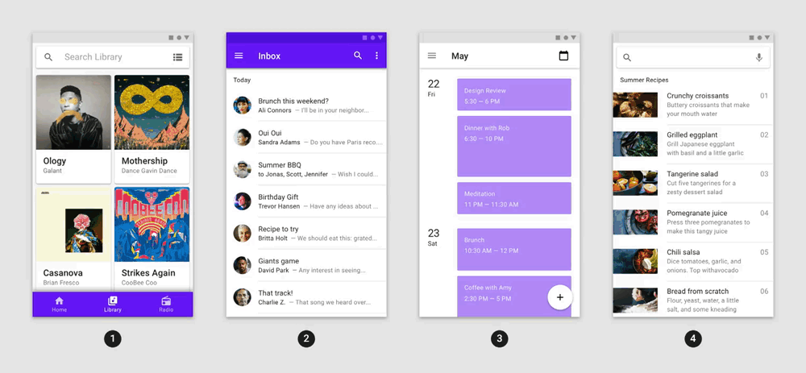
UI/UX
Flutter’s animations package includes pre-made animations for commonly-desired effects.

Slide 37

Gaming
flame is an engine which provides utility functions and APIs useful for game development, including:
Game loop
Characters and objects movement.
Collision detection.
Images, animation and sprites.

Slide 38
Plans For Today
Understand what Flutter’s all about and why is it recommended to use.
Learn the basic UI concepts in depth.
See some actual code and play with it.
Overview interesting features and packages that might be useful for your projects.
Get to know great self-learning sources, mainly for documentation, packages, etc.
Questions?

Slide 39
Useful Links
For packages, check out pub.dev.
For widgets & APIs, check out Flutter’s catalog.
For learning about new widgets, check out the “Widget of the Week” YouTube playlist.
For advanced articles about Flutter, check out Medium’s Flutter community.
If you have questions, try to contact me ☺

Slide 40
Plans For Today
Understand what Flutter’s all about and why is it recommended to use.
Learn the basic UI concepts in depth.
See some actual code and play with it.
Overview interesting features and packages that might be useful for your projects.
Get to know great self-learning sources, mainly for documentation, packages, etc.
Questions?

Slide 41
THANK YOU!

